Slide 1
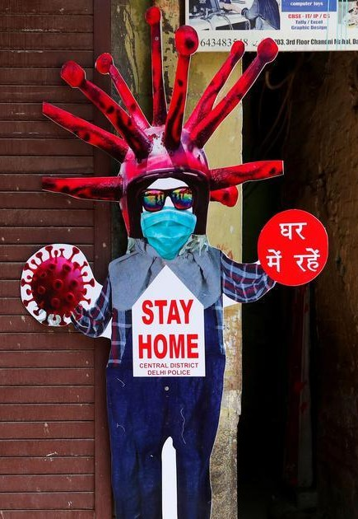
Breathing in 2021
Data Visualization on COVID-19
Analysis and Insights – Using Python

Slide 2

This is a Project of Scientiﬁc Data Visualization of COVID-19 Pandemic on Human Life. Global Datasets were collected for Insights & Analysis has been done on them. This project is a product of Learnings.

Slide 3

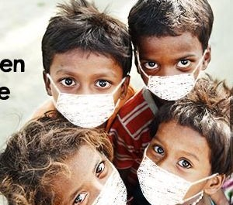

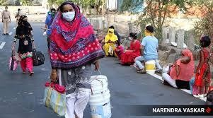
INTRODUCTION
COVID-19 is an infectious disease caused by the recently found virus known as SARS-CoV-2 (or coronavirus). Before the outbreak originated in Wuhan, China on December 2019, there was no information about this virus
COVID-19

Slide 4
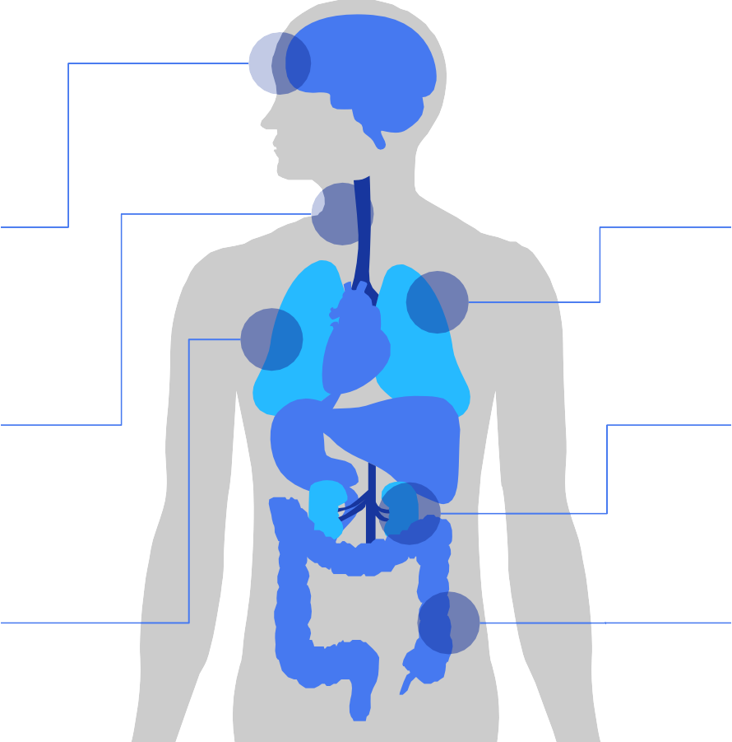
PHYSICAL EXAMINATION
COMMON SYMPTOMS
EVENTUAL SYMPTOMS
FEVER
The body temperature can exceed 37.3 ºC
PNEUMONIA
Inﬂammation of both lungs
DRY COUGH
Constant coughing without expelling mucus
KIDNEY FAILURES
Kidney failures can result in vomiting
BAD BREATHING
Breathing actually feels
more difﬁcult
GASTRO DISORDERS
The patient may suffer from diarrhea
COVID-19

Slide 5
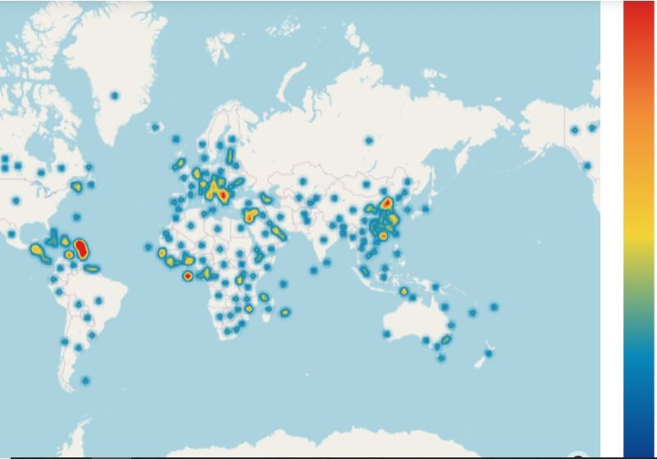
Global Scenario while COVID was decleared Pandemic by WHO

Slide 6
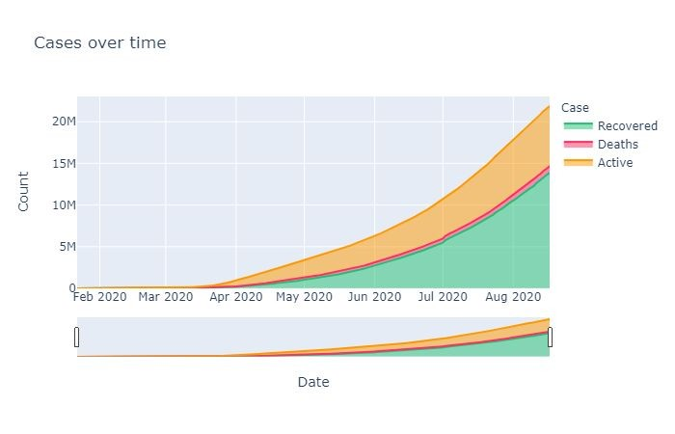
Observation:
The steep rise in cases in April is due to the lack of understanding of its impact in countries outside China.
Recoveries improved with improved understanding and Precautionary Lockdowns and other measures.

Slide 7
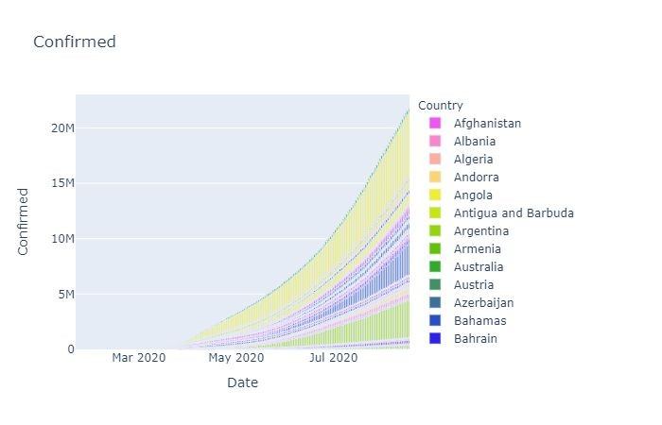
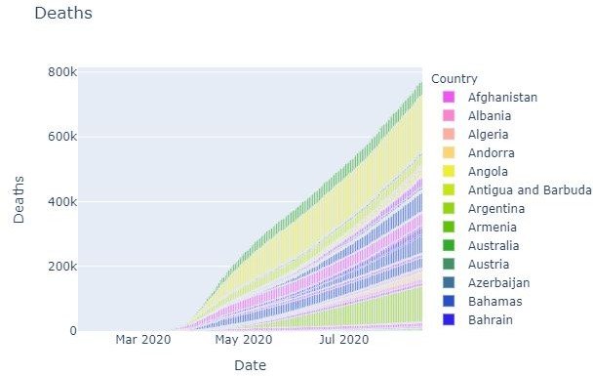
Observation:
With social distancing the only way known but still to be a learnt behaviour, the virus started spreading exponentially all over the world. The high human movement in big cities acted as the catalyst for the pace of spread.

Slide 8
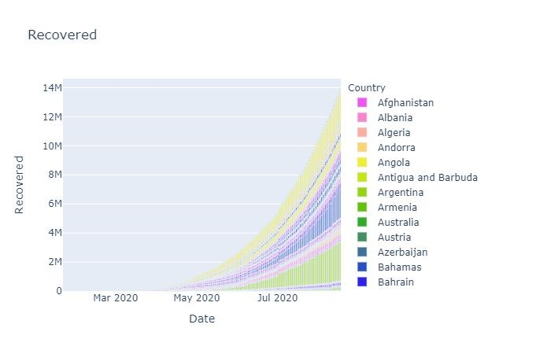
Observation:
Started as Pneumonia in Wuhan in Dec2019, the Corona Virus started showing signs of becoming a global pandemic from April 2020.

Slide 9
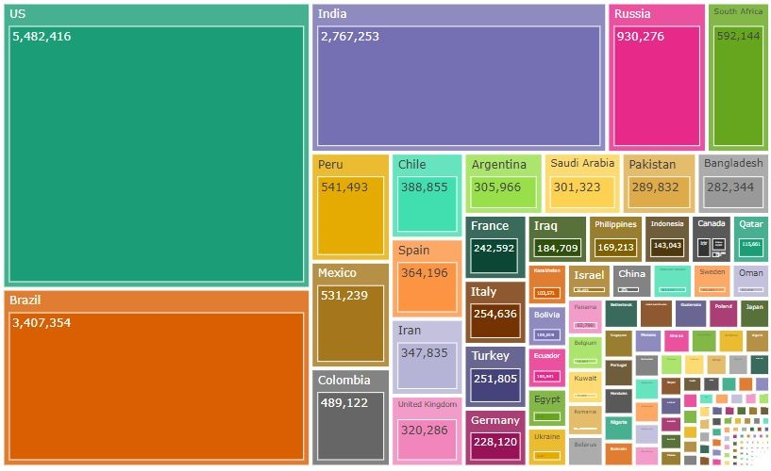
CONFIRMED CASES
COVID-19

Slide 10
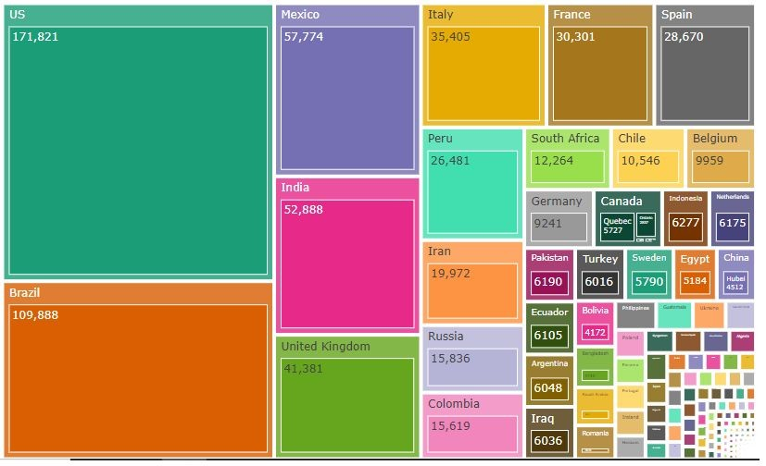
Death Cases
COVID-19

Slide 11
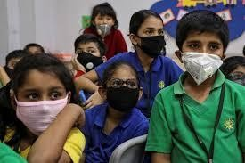
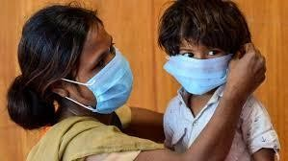

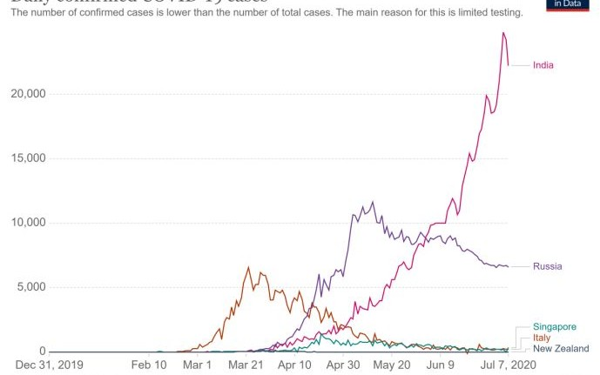
India
India is putting up a brave fight against the COVID, starting with its early lockdown in March and strict curfews. However, it still has not been able to flatten its daily cases like Singapore, New Zealand and Russia did despite starting their lockdown days after India did.
The objective of this notebook is to provide a state-wise breakdown of the virus’ spread to glean a few insights on how to better combat the crisis.
COVID-19

Slide 12
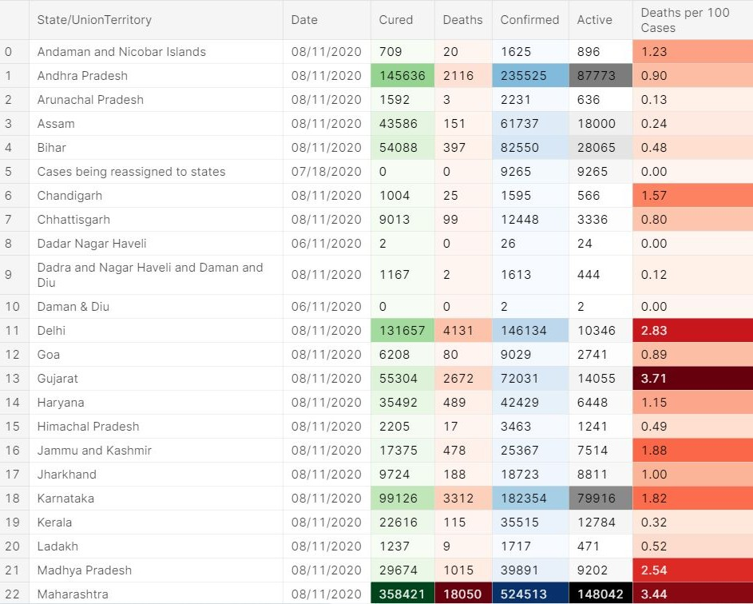
Observation:
At first glance, the main virus hotspots seem to be the most populous states of the country. But it does not follow that general trend, with Delhi having the 3rd highest confirmed cases but a comparatively lower population. Let's do some analysis.

Slide 13
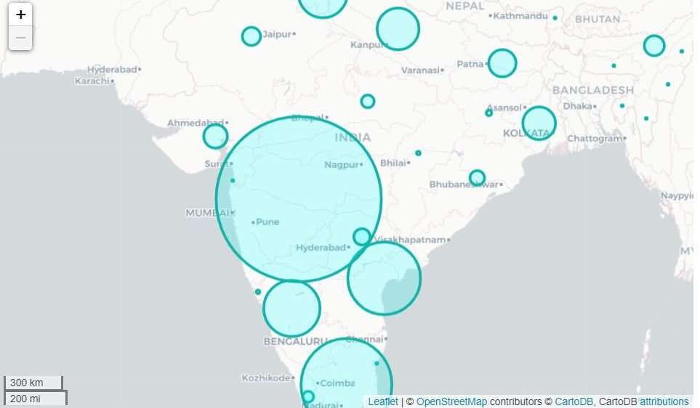
Major Hotspots in India
Observation:
We can deduce that the worst-struck states of India are the ones with densely packed urban areas, like Mumbai in Maharashtra, Chennai in Tamil Nadu and New Delhi. Let's see how the total national confirmed cases are distributed.
We can deduce that the worst-struck states of India are the ones with densely packed urban areas, like Mumbai in Maharashtra, Chennai in Tamil Nadu and New Delhi. Let's see how the total national confirmed cases are distributed.

Slide 14
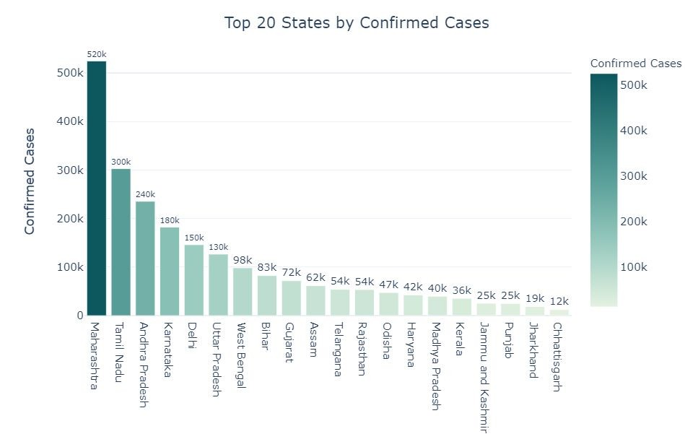
Observations:
MH has the most number of cases being an International destination as well as having large number of densely populated urban pockets.

Slide 15
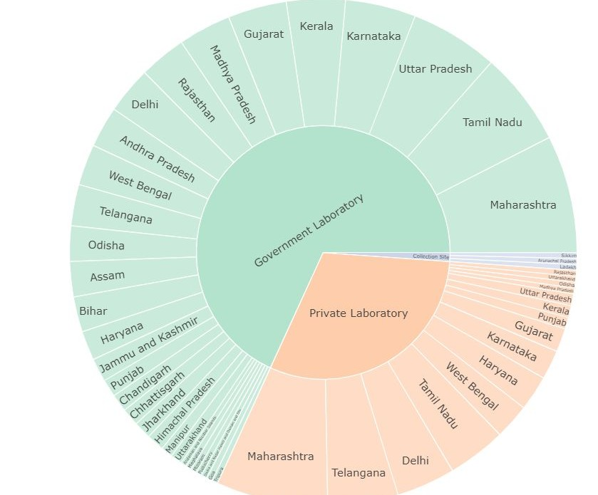
State wise Lab Facilities
Observation:
Government Labs: MH>TN>UP
Private Labs: MH > TGN > DL

Slide 16
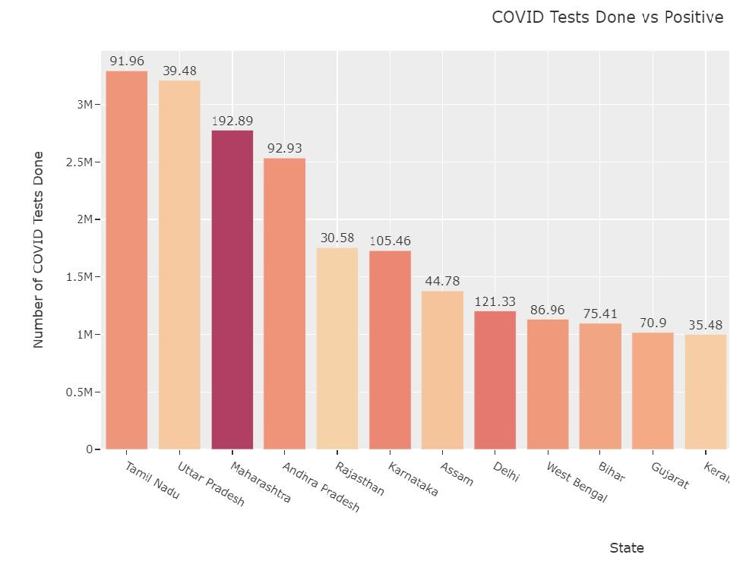
Observation:
Maharashtra , Delhi
,Telangana need to increase their testing as
>10% of their tests are positive. Our prime weapon against COVID is detection, contact tracing and breaking the chain.
Andhra Pradesh has done well to have a highest test rate despite a limited count of health care institutions in state.

Slide 17

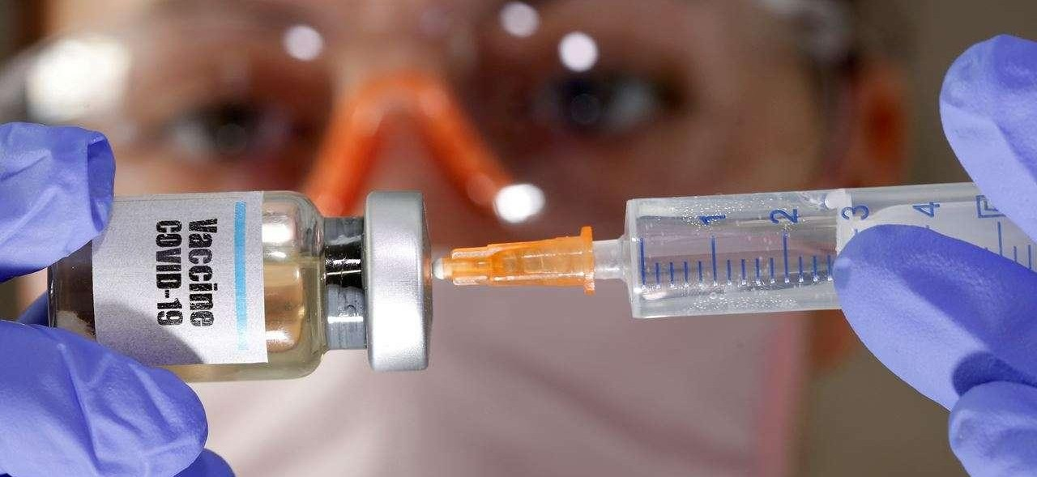

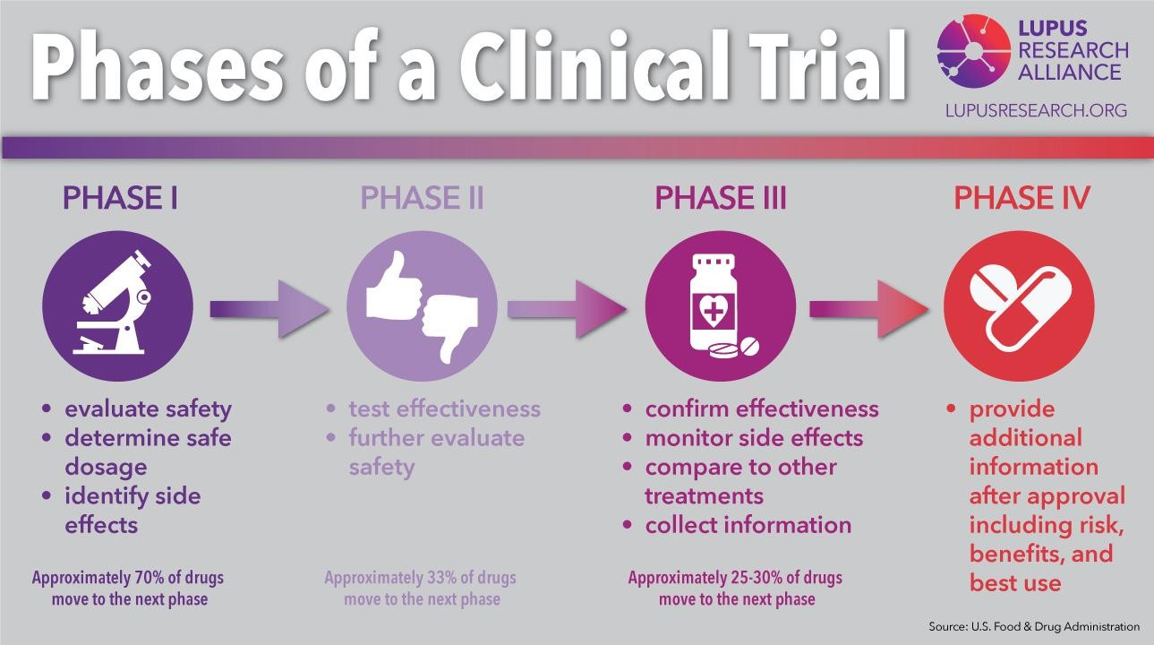

Clinical Trials

Slide 18
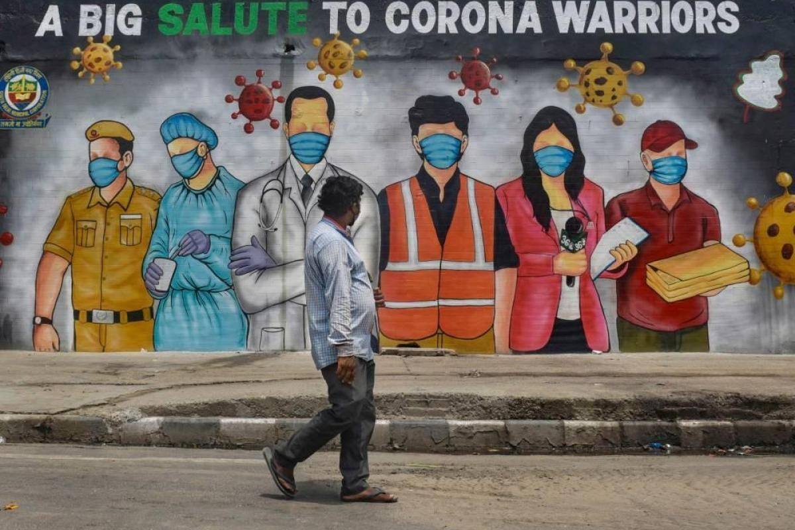

Slide 19

References
Ministry of Health and Family Welfare.
John Hopkins University github link
keggle.com
github.com
covid19india.org
google.com (for photographs)
Python Libraries Used-
Pandas
Numpy 3.Matplotlib 4.Folium 5.Plotly 6.Seaborn
For Code and Datasets, Please visit-
https://github.com/Sadique96645?tab=repositories

Slide 20


Thank You! SADIQ Data Scientist

